Slide 1

Prepared by team LEVISA
FootFall
Enhancing Product Sales Strategy
1 december, 2024

Slide 2


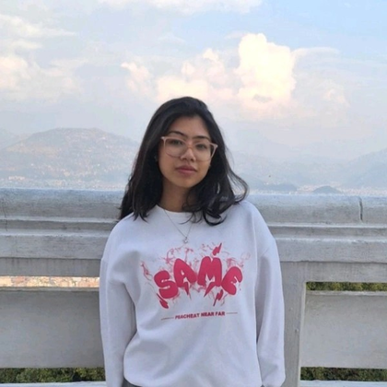

Team Members
Rubina Maharjan
Loonibha Tamrakar
Alishna Sharma

Slide 3
Problem Statement
Lack of dependable footfall tracking leads to inefficient resource allocation, poor crowd management, and missed opportunities for enhancing sales and customer satisfaction.

Slide 4
Introduction
Our project aims to develop an advanced footfall tracking system for shopping centers, utilizing real-time data and analytics to optimize space utilization, enhance customer experience, and improve operational efficiency.

Slide 5
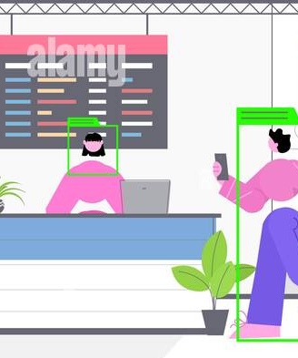
Understanding FootFall
Customer Traffic
Footfall measures the number of people entering a specific location, such as a store, mall, or conference center.
.
Real-Time Data
Footfall analytics systems provide real-time data on customer traffic, allowing businesses to make informed decisions.
Data collection
Footfall is collected using various methods, including cameras, sensors, and mobile device tracking.

Slide 6


Our Architecture
Use Custom Trained YOLO model
Add to database
Detect people exiting and entering the gate
Use bounding boxes and tracking
Add to database for later analysis

Slide 7
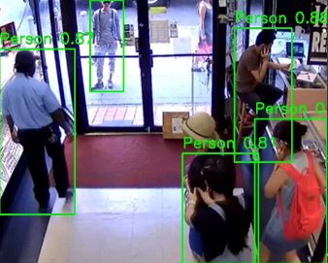
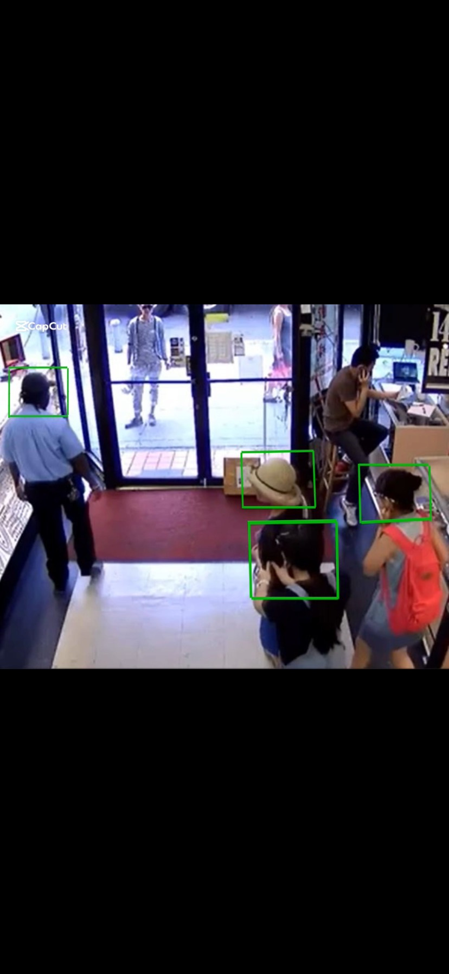

Slide 8
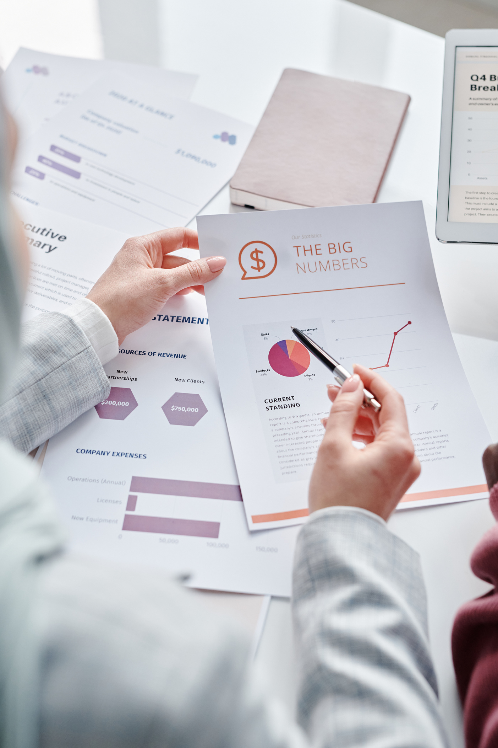
Application
Understanding Customer Behavior
Optimizing Operations
Marketing and Promotion
Tenant Management
Revenue Optimization

Slide 9

Future Enhancement
To detect male vs female and child vs adult
tracking persons movement
Integrating IOT
enables tracking of a person's movement through the store to determine which stall has the highest inventory
Analyze sales performance, market trends, and consumer behavior.
Conduct a SWOT analysis of existing sales strategy.
Leverage IoT devices for real-time tracking, predictive insights, and seamless data processing to optimize operations and enhance customer experiences.

Slide 10

Application Beyond Retail
Conference Centers
Footfall data can be used to optimize conference room scheduling, catering, and event planning.
Hospitals and Healthcare
Footfall analytics can help manage patient flow, optimize waiting areas, and improve patient care.
Transportation Hubs
Footfall data can be used to track passenger flow, manage crowds, and optimize public transportation schedules.

Slide 11
BUDGET
Market level budget
1.Development Costs
2.Cloud Hosting
3.Marketing
Revenue
1.Initial Installment
2.Monthly Management Cost

Slide 12
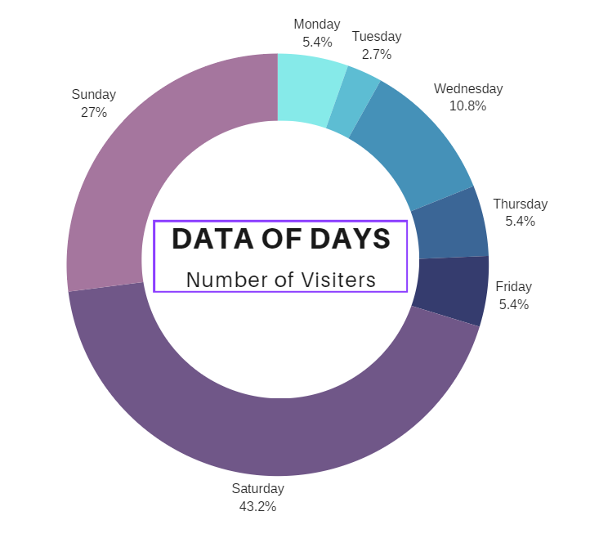
Data Analysis

Slide 13
Thank you

